Slide 1
Malware Analysis
Dr. Tran The Son
Vietnam – Korea University

Slide 2
Dynamic Malware Analysis
Environment
  VMWare
  VirtualBox
  Parallels
  Virtual PC
  QEMU
Physical machine
App.
Virtual machine
App.
App.
App.
App.
Guest OS
OS

Slide 3
Dynamic Malware Analysis
Virtual Machine
Physical Machine
External Network
Host-only Networking
NIC
NIC
NIC
Physical Machine
External Network
NAT Networking
Bridge Networking
Custom Networking
VMNet0: Bridging
VMNet8: NAT
NIC
Virtual Machine
Service
NIC
VMNet
Virtual Machine
Analysis
NIC

Slide 4
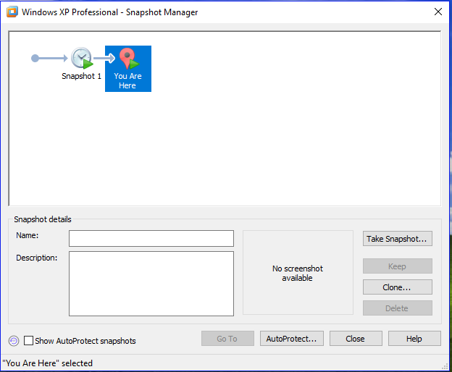
Dynamic Malware Analysis
Snapshot
  Restore points

Slide 5
Dynamic Malware Analysis
Techniques and tools
  Sandbox: Cucco, Norman, GFI, Anubis, Joe, …
  Process Monitor/Explorer
  Regshot
  ApateDNS, Netcat…
  Wireshark
  InetSim: Linux-based

Slide 6
Dynamic Malware Analysis
Running Malware
  Double-click: EXE, DLL
  Apply rundll32.exe
  Export arguments: by using PEview hoặc PE Explorer.
  E.g. rip.dll (export : Install và Uninstall); ipr32x.dll (export: InstallService)
C:\rundll32.exe DLLname, Export arguments
C:\rundll32.exe rip.dll, Install
C:\rundll32.exe ipr32xdll, InstallService ServiceName
C:\net start ServiceName

Slide 7
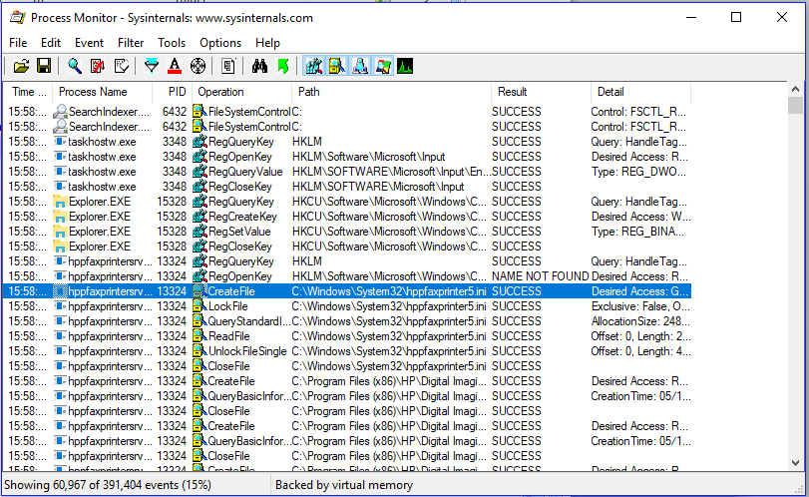
Dynamic Malware Analysis
Process Monitoring (procmon.exe)

Slide 8
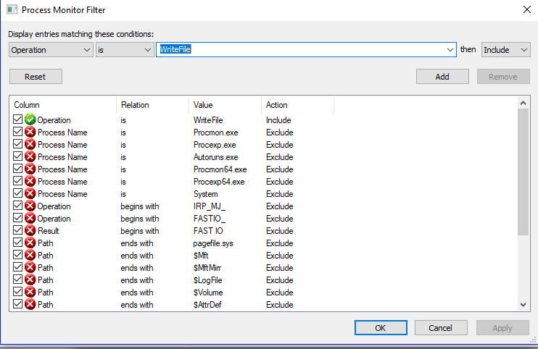
Dynamic Malware Analysis
Process Monitoring –> Filter
  Important fields: Process Name, Operation, Detail
  Common functions: RegSetValue; CreateFile; WriteFile.

Slide 9
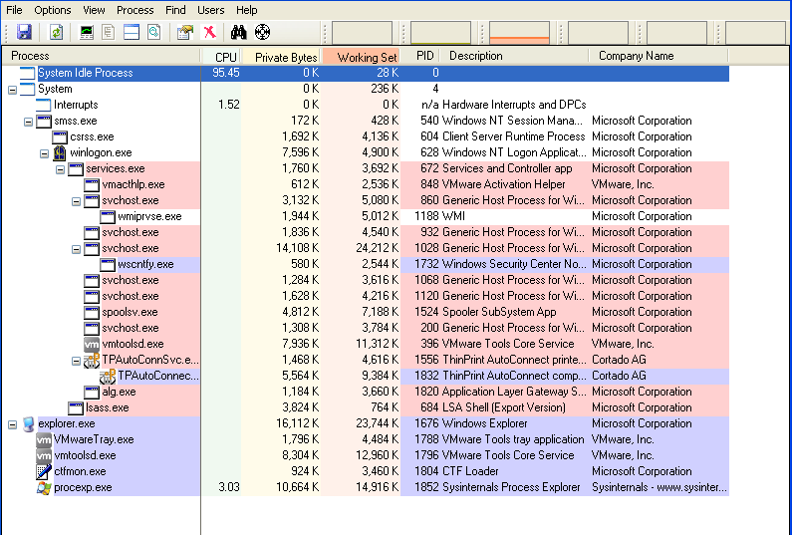
Dynamic Malware Analysis
Process Explorer (procexp.exe)
  Name
  PID
  CPU
  Description
  Company

Slide 10
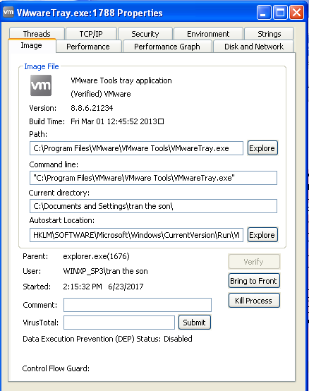
Dynamic Malware Analysis
Process Explorer -> Verify
  MS uses digital signatures for most of its core executables.
  Malware often replaces authentic Windows files with its own in an attempt to hide

Slide 11
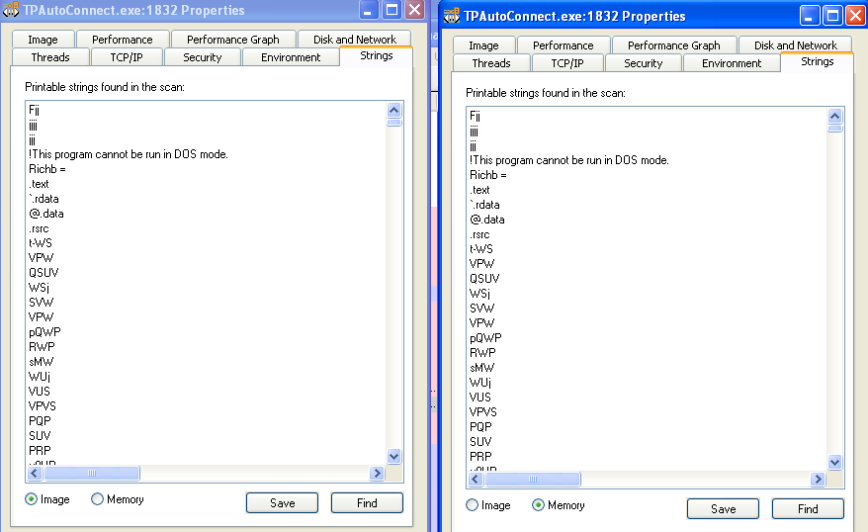
Dynamic Malware Analysis
Process Explorer -> Compare Strings
  Compare strings contained in the disk executables (images)against strings in memory to recognize the replacements

Slide 12
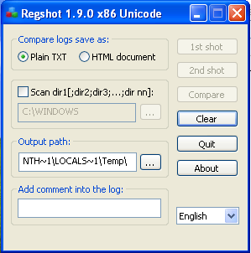
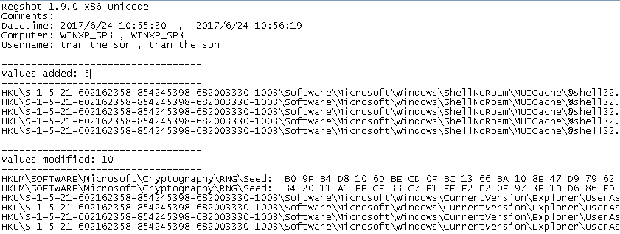
Dynamic Malware Analysis
Comparing Registry snapshots by Regshot

Slide 13
Faking a Network
Malware often beacons out and eventually communicates with a command-and-control server.
A fake network allows us to obtain network indicators (DNS names, IP, packet signatures) without connecting to the Internet.
Some malware can realise that it is executing in a virtualized environment (e.g. VMware).
Tools:
  ApateDNS
  Netcat
  FakeNet

Slide 14
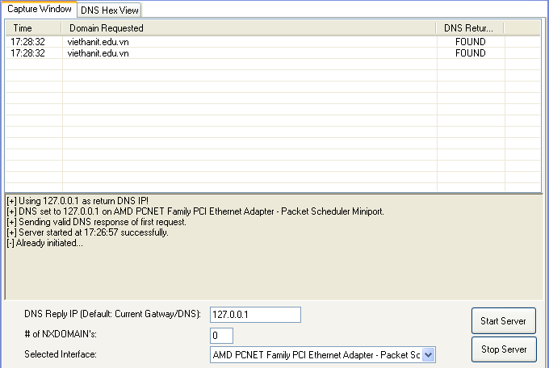
Faking a Network
ApateDNS (sdl-apateDNS)
(https://www.fireeye.com/services/freeware/apatedns.html)

Slide 15
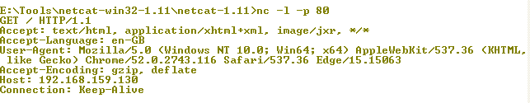
Network Monitoring
Netcat
  Monitoring common ports used by malwares (80, 443, …)

Slide 16
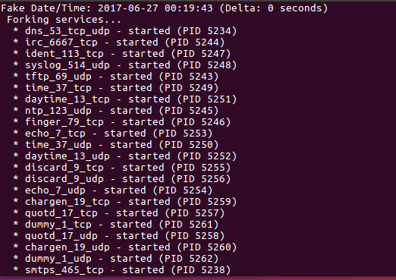
Network Monitoring
INetSim (www.inetsim.org): Linux-based app

Slide 17
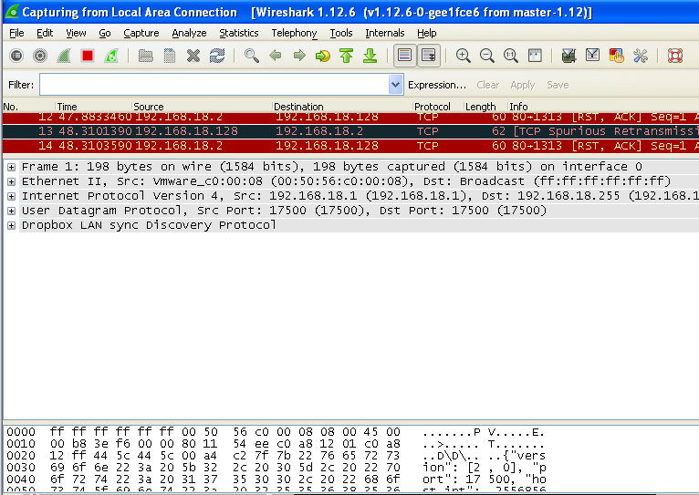
Network Monitoring
Wireshark

Slide 18
Practice
Surface analysis
  VirusTotal
  Strings
  Peview/PEiD
Run monitoring tools
  Process monitor
  Process explorer
  Wireshark
  Regshot
Activate malware
Check & analysis

Slide 19
Practice 3 [Surface & Dynamic Analysis]
  PE File: Lab03-01.exe,
Questions
  What are the malware’s imports and strings? (Surface Analysis)
  What are the malware’s host-based indicators
  Are there any useful network-based indicators for this malware? If so, what are they?
  How to detect and remove the malware?
Project idea
  Write a simple program
    Detect the malware
    Remove the malware off the infected PC
Notes:
1. The malware appears to be packed. The only import is ExitProcess,
although the strings appear to be mostly clear and not obfuscated.
2. The malware creates a mutex named WinVMX32, copies itself into C:\
Windows\ System32\vmx32to64.exe. and installs itself to run on system
startup by creating the registry key HKLM\SOFTWARE\Microsoft\Windows\
CurrentVersion\Run\VideoDriver set to the copy location.
3. The malware beacons a consistently sized 256-byte packet containing
seemingly random data after resolving www.practicalmalwareanalysis.com.

Slide 20
Lab03-01.exe Analysis
Import
  Kernel32.dll (CreateFile, WriteFile, MapFile, …)
Strings
  Kernel32.dll
  Ws2_32
  SOFTWARE\Classes\http\shell\open\commandV
  Software\Microsoft\Active Setup\Installed Components\
  test
  www.practicalmalwareanalysis.com
  admin
  VideoDriver:
  WinVMX32
  vmx32to64.exe
  SOFTWARE\Microsoft\Windows\CurrentVersion\Run
  SOFTWARE\Microsoft\Windows\CurrentVersion\Explorer\Shell Folders

Slide 21
Practice 4 [Surface & Dynamic Analysis]
PE file: Lab03-02.dll
Questions
  Import & Export?
  How can you get this malware to install itself?
  How would you get this malware to run after installation?
  How can you find the process under which this malware is running?
  Which filters could you set in order to use procmon to glean information?
  What are the malware’s host-based indicators?
  Are there any useful network-based signatures for this malware?
Notes:
1. To install the malware as a service, run the malware’s exported installA
function via rundll32.exe with rundll32.exe Lab03-02.dll,installA.
2. To run the malware, start the service it installs using the net command
net start IPRIP.
3. Use Process Explorer to determine which process is running the service.
Since the malware will be running within one of the svchost.exe files on
the system, hover over each one until you see the service name, or search
for Lab03-02.dll using the Find DLL feature of Process Explorer.
3
486 Appendix C
4. In procmon you can filter on the PID you found using Process Explorer.
5. By default, the malware installs as the service IPRIP with a display name of
Intranet Network Awareness (INA+) and description of “Depends INA+, Collects
and stores network configuration and location information, and
notifies applications when this information changes.” It installs itself for
persistence in the registry at HKLM\SYSTEM\CurrentControlSet\Services\IPRIP\
Parameters\ServiceDll: %CurrentDirectory%\Lab03-02.dll. If you rename
Lab03-02.dll to something else, such as malware.dll, then it writes malware.dll
into the registry key, instead of using the name Lab03-02.dll.
6. The malware resolves the domain name practicalmalwareanalysis.com and
connects to that host over port 80 using what appears to be HTTP. It
does a GET request for serve.html and uses the User-Agent %ComputerName%
Windows XP 6.11.

Slide 22
Practice 4 [Surface & Dynamic Analysis]
PE file: Lab03-03.exe
Questions
  What happening when this malware executes (monitoring by Process Explorer)?
  Identify any live memory modification?
  What are the malware’s host-based indicators?
  What is the goal of this malware?
Project idea
  Write a simple program to
    Detect the malware
    Remove the malware off the infected PC

Slide 23
Practice 4 [Surface & Dynamic Analysis]
PE file: Lab03-04.exe
Questions
  What happens when you run this file?
  What is causing the roadblock in dynamic analysis?
  Are there other ways to run this program?

Slide 24
Practice [A real virus]
A real virus: Trojan.Win32.Mooze
  Download from virusshare.com
  SHA256
    855e3aa2a4b8432f5a2b77a6aa2635ae8382ca6df76b4c0d7405856faa7b5b5b
  MD5
    efc05e673dc516a6a96bc346dc7c93a6

Slide 25
Project idea
Write a simple program for monitoring processes running in Windows
Write a simple signature and/or behaviour-based malware detection and removal program
  Collect & store the malware signatures & behaviours
  Options:
    Quick scan: signature-based scan
    Full scan: behaviour-based scan
    https://virustotalapi3.readthedocs.io/en/latest/
    ftp://ftp.viethanit.edu.vn => MalwareAnalysis -> Python Code

